Slide 1
Robot Perception and Sensing
By : Ramakant Ganjeshwar

Slide 2
What is Robot Perception
Perception is the One of the most important Capabilities. For human robot interaction.
We investigate general perception task crucial for human robot interaction. such as
Where the objects are located in the room
What objects in the scene.
How they interact with humans.
We first enumerate representative social robots and summarize the most three important perception method.

Slide 3
Perception method
We first enumerate representative social robot and summaries the most three important perception method from these robot :
Feature extraction
Dimensionality Reduction
Semantic Understanding

Slide 4
Sensory modalities in robotics
Robots are system that sense, actuate and Compute. So far we have studied the basic principal of actuation.
We now need to understand the basic principals of robotics sensor that provide the data basis for computation.

Slide 5
Sensory modalities in robotics
Robotic Sensor
Proprioception of robot kinematic and internal process
Sensor Using light
Sensor Using Sound

Slide 6
Goal of this chapter is
Overview of sensors commonly used on robotic systems.
the physical principles that are responsible for uncertainty in sensor-based reasoning.

Slide 7
Robotic Sensor
The development of sensors is classically driven by industries other than robotics.
These include submarines, automatically opening doors, safety devices for industry, servos for remote controlled toys, and more recently the cell-phone, automobiles and gaming consoles.
These industries are mostly responsible for making "exotic" sensors available at low cost by identifying mass-market applications.
e.g., accelerometers and gyroscopes now being used in mass-market smart phones or the 3D depth sensor “Kinect” as part of its XBox gaming console.

Slide 8
Robotic Sensor
As we will see later on, sensors are hard to classify by their application.
In fact, most problems benefit from every possible source of information that they can obtain.
For example, localization can be achieved by counting encoder increments, but also by measuring acceleration, or using vision.

Slide 9
Robotic Sensor
All of these approaches differ drastically in their precision and the kind of data that they provide, but none of them is able to completely solve the localization problem on its own.
This is therefore organized by the physical quantities (and derivatives thereof),
a sensor is measuring, instead of the higher level state estimates it can contribute to.

Slide 10
Robotic Sensor
an encoder is able to measure position, it is used in this function only on robotic arms.
If the robot is non-holonomic, closed tours in its configuration space, i.e., robot motions that return the encoder values to their initial position, do not necessarily drive the robot back to its starting point.
In those robots, encoders are therefore mainly useful to measure speed.
An accelerometer instead, by definition, measures the derivative of speed.

Slide 11
Robotic Sensor
Vision, finally, allows to calculate the absolute position (or the integral of speed) if the environment is equipped with unique features. An additional fundamental
difference between those three sensors is the amount and kind of data they provide.
An accelerometer samples real-valued quantities that are digitized with some precision.

Slide 12
Robotic Sensor
An odometer instead delivers discrete values that correspond to encoder increments.
Finally, a vision sensor delivers an array of digitized real-valued quantities (namely colors).
Although the information content of this sensor exceeds that of the other sensors by far, cherry-picking the information that are really useful remains a hard, and largely unsolved, problem.

Slide 13
Proprioception of robot kinematic and internal process
Proprioception refers to the perception of internal states of robot.
This is different from exteroception, which describes Sensing of anything outside of the robot.
Proprioception includes awareness of the robots joints angles, its speeds as well as torques and forces.

Slide 14
Proprioception of robot kinematic and internal process
The main internal sensor is therefore the encoder. Encoder can be used for Sensing joints, positions and speed as well as when used together with a spring a simple force sensor.
There are both incremental and absolute encoders. The latter are mostly used in industrial applications, but are not common in mobile robotics.

Slide 15
Proprioception of robot kinematic and internal process
There are magnetical and optical encoders, which both rely on a magnetic or optical beacon turning together with the motor and being sensed by an appropriate sensor that counts every pass-through.
The most common encoder in robotics is the optical quadrature encoder. It relies on a pattern rotating with the motor and an optical sensor that can register black/white transitions.

Slide 16
Proprioception of robot kinematic and internal process
Whereas those patterns can be precision manufactured, simple encoders can be made by simply laser-cutting a pattern such as shown in Figure 5.1 and reading it with a light sensor.

Slide 17
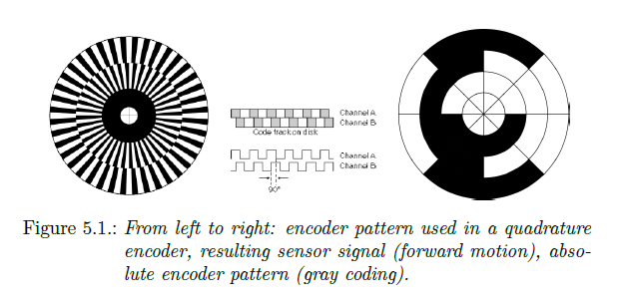
Proprioception of robot kinematic and internal process

Slide 18
Sensor Using light
The small form factor and low price of light-sensitive semiconductors have led to a proliferation of light-based sensing relying on a multitude of physical effects.
These include reflection, phase shift, and time of light.

Slide 19
Reflection
Reflection is one of the principles that is easiest to exploit: the closer an object is, the more it reflects light shined at it.
This allows to easily measure distance to objects that reflect light well and are not too far away. In order to make these sensors as independent from an object's color (but unfortunately not totally independent), infrared is most commonly chosen.
A distance sensor is made from two components: an emitter and a receiver.

Slide 20
Reflection
They work by emitting an infrared signal and then measuring the strength of the reflected signal.
A typical response is shown in Figure 5.2. The values obtained at an analog-digital converter correspond to the voltage at the infrared receiver and are saturated for low distances (at line),and quadratically fall o thereafter.

Slide 21
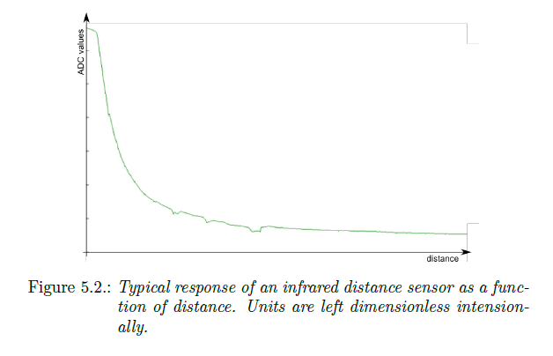
Reflection

Slide 22
Phase shift
briefly turns of and then starts getting brighter again.
Thus, if you would plot the amplitude, i.e. its brightness, of the emitted signal vs. time you would see a wave that has zero-crossings when the light is dark.

Slide 23
Time of flight
The most precise distance measurements light can provide is by measuring its time of light. This can be done by counting the time a signal from the emitter becomes visible in the receiver.
As light travels very fast (3,000,000,000m/s), this requires highspeed electronics that can measure time periods smaller than nano-seconds in order to achieve centimeter accuracy.

Slide 24
Sensor using Sound
Ultra sound distance sensor
Texture recognition

Slide 25
Ultra sound distance sensor
An ultra-sound distance sensor operates by emitting an ultrasound pulse and measures its reflection.
Unlike a light-based sensor that measures the amplitude of the reflected signal, a sound-based sensor measures the time it took the sound to travel.
This is possible, because sound travels at much lower speed (300m/s) than light (300,000km/s). The fact that the sensor actually has to wait for the signal to return leads to a trade-of between range and bandwidth.

Slide 26
Texture recognition
Audible sound consists of high frequency vibrations in the range between 20 Hz and roughly 15 kHz. Microphones are therefore ideally suited to measure vibrations in this range.
This allows them to double as the Pascinian corpuscle in human skin cells,
which is known to have a resonance frequency of 250 Hz and is mostly responsible for texture recognition.

Slide 27
Inertia-based sensors
A moving mass does not loose its kinetic energy, but for friction.
Likewise, a resting mass will resist acceleration. Both effects are due to "inertia" and can be exploited to measure acceleration and speed.
Inertia based sensors are Accelerometer and Gyroscopes.

Slide 28
Accelerometer
An accelerometer can be thought of as a mass on a dampened spring.
Considering a vertical spring with a mass hanging down from it, we can measure the acting force F = kx (Hooke's law) by measuring the displacement x that the mass k has stretched the spring.
Using the relationship F = am, we can now calculate the acceleration a on the mass m.

Slide 29
Beacon-based sensors
Localizing an object by triangulation goes back to ancient civilizations orienting themselves using the stars.
As stars are only visible during unclouded nights, seafarers have eventually invented systems of artificial beacons emitting light, sound, and eventually radio waves.
The most sophisticated of such systems is the Global Positioning System (GPS).
GPS consists of a number of satellites in orbit, which are equipped with knowledge about their precise location and have synchronized clocks.

Slide 30
Beacon-based sensors
These satellites broadcast a radio signal that travels at the speed of light and is coded with its time of emission. GPS receivers can therefore calculate the distance to each satellite by comparing time of emission and time of arrival.

Slide 31
Thankyou

